Slide 1
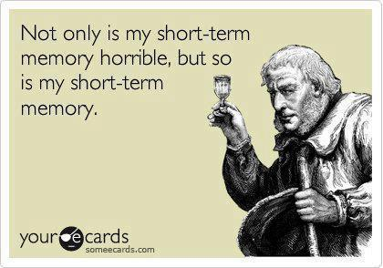
Chapter 8
Memory

Slide 2
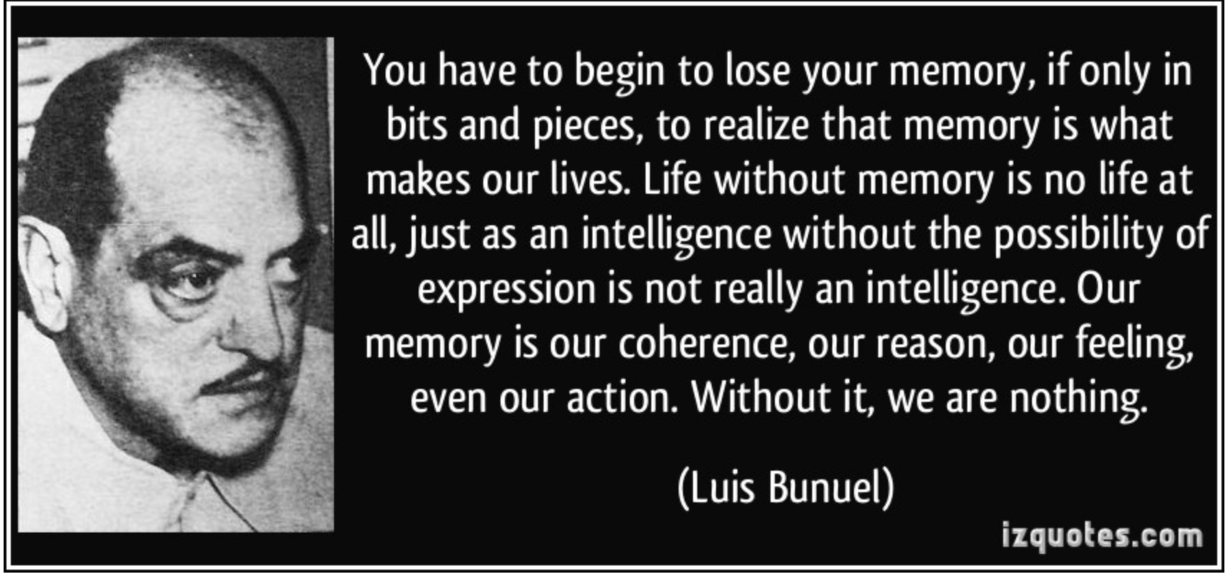
Importance of Memory

Slide 3
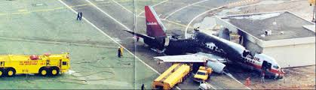
The Nature of Memory
How does new information turn into memories?
3 basic functions of memory
3 stages of memory storage
Distinguish between procedural vs. declarative and semantic vs. episodic
Notes:
Today you are going to learn about the nature of memory from you book section 8.1
Your book wants you to be able to know the functions of memory, the stages of memory, and to be able to distinguish between the different types of memory.

Slide 4
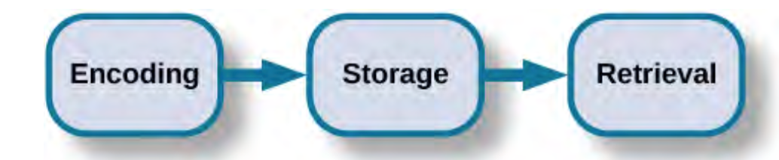
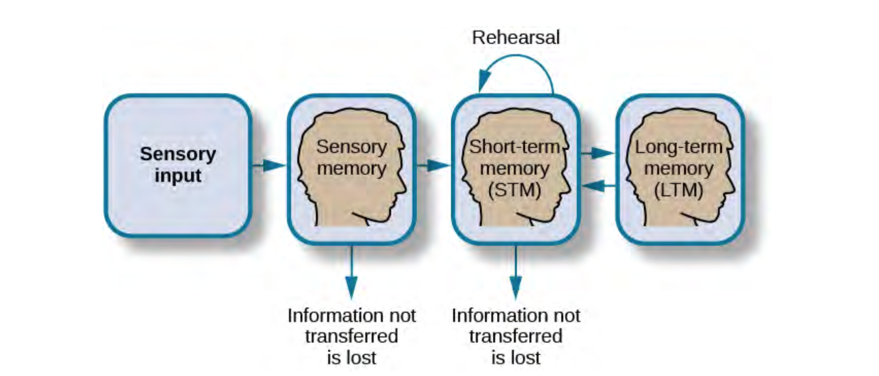
Basic Memory Processes
Encoding (automatic or effortful)
Auditory (acoustic) memory
Visual memory
Semantic memory
Storage
Retrieval
Recall
Recognition
Notes:
These pictures here give you another overview of memory by showing you the order of the stages you are going to learn about: we’ll start with learning about the types of encoding and then go on the learn about storage and retrieval of memories
Automatic encoding: time, space frequency, meaning of words (last time you studies a test, remembering time of day)
Effortful: when you study for a test or learn a new language, you had to put a lot more attention and effort into learning.
Storage: permanent record of of the material
Recognition: identify info you have encountered before: uses a process of comparison (multiple choice test)
Recall: access without cues (essay test)

Slide 5
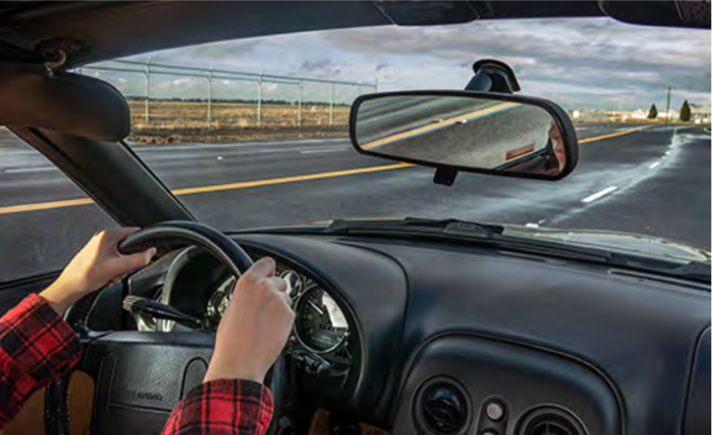
Encoding
Automatic: details like time of day, space, frequency, and the meaning of words
Effortful: learning that require attention and effort
rehearsal
Notes:
Encoding is method that we get new information that we perceive out in our environment into our brain’s memory system.
Once in the memory system, our brains label of code this new information for understanding and possible future use. This process of encoding can be done in two ways: either automatically or with effort.
Automatic encoding is a process that’s completed without conscious awareness. We don’t know that we are automatically encoding information, It just happens. We automatically encode details like time of day, the shape of space around you: for example, you don’t have to consciously think around remembering that your neighbor always walking her two dogs during the day, its information about your environment that is just automatically processing
Another example of automatic encoding is the meanings of words. Its important to note that we only automatically encode new meanings of languages that we already know: example of reading a book or talking with a friend and a new word is used that you understand what the meaning is out of context of the conversation, you are most likely automatically encoding that new word without much effort.
These are in contrast to effortful encoding, which takes lot of attention and effort on our part to encode: effortful encoding is done when through rehearsal, studying, and making associations between new and old material. We process peoples names and telephone numbers this way, because we have to put effort in remembering it later. For every test you have taken, you have had to effortfully encode information to remember it on the test
However:
Tasks can go from being effortful to procedural: driving a car. And learning, or encoding new information about driving can happen automatically.

Slide 6
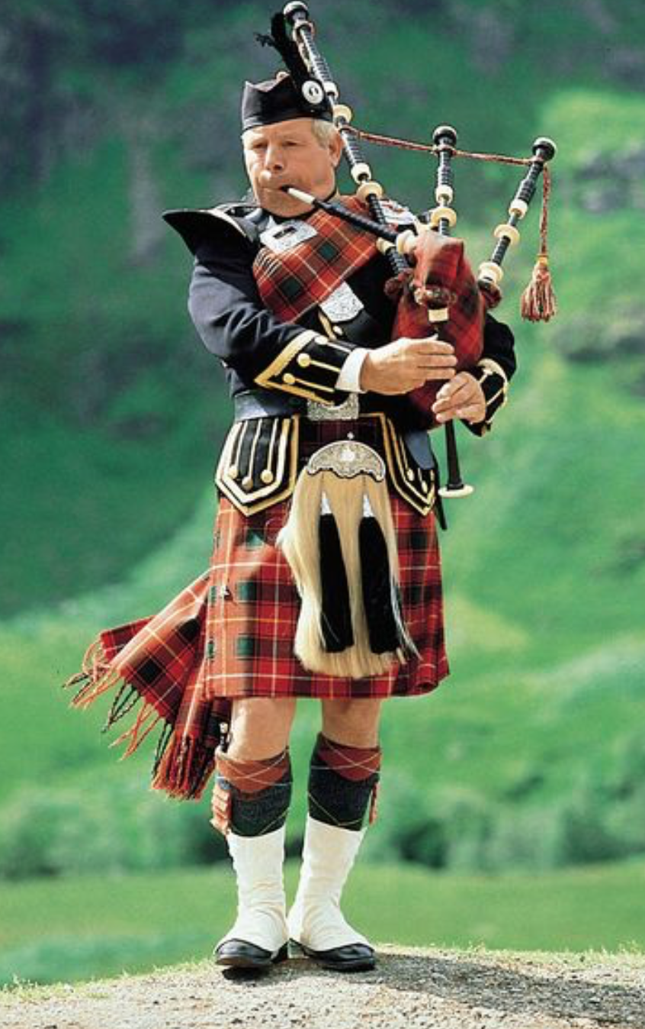
How to Encode Effectively?
The more meaningful, the easier it is to recall
The notes were sour because the seams split
Prompt: Bagpipes
The prompt word bagpipes helps to give the sentence context and meaning and is thus easier to remember
Notes:
One easy way to encode more effectively is to find a way to make what you are trying to encode more meaningful. The more meaningful information is, the easier it will be to encode and recall later.
The book has several good example sentences that demonstrate this concept. This sentence is a really good example: If you saw this sentence alone, if would be difficult to memorize because it is confusing without meaning or context. But if you are given context for it, such as a prompt word that gives meaning to the sentence, it will become much easier to recall than the sentence was before.

Slide 7
Types of Encoding
Visual: encoding of images
Auditory: encoding of sounds
Semantic: encoding of words and their meanings
Notes:
Auditory: songs for kids
Visual: the encoding of images: you will better remember words if they have images attached to them: EX: Car vs. Truth
Semantic: memory of words and their meanings, high imagery words are encoded both visually and semantically

Slide 8


Visual Encoding
Images can be recalled more easily than words alone
High-imagery words are easier to recall
Consider the words:
Car, level, dog, truth, book, value
Notes:
The encoding of images: Images can be recalled more easily than words alone. Importantly, high-imagery words are much easier to recall. Take these words for example:
The words that it is easy to conjure up a image of and an object are much easier to remember then words that are more abstract and low-imagery. The picture on the left is actually the only image I found whnen searching the word truth that didn’t have the word written in the picture. This kind of low imagery word will be more difficult to recall out of a set of words
Another fact about visual encoding is that words that are written in all capital letters or in italics will be recalled more easily than words that are written normally. You can use this phenominon to your advance when you study ad take take notes: I like to put words the I’m having a difficult time remembering in all capital letters as I’m studying so that I’ll remember it better.
While you can use these of kinds of techniques to to your advantage in remembering, In general, visually encoded information is very fleeting and is forgotten easily… we can remeber information better is we also use auditory and semantic encoding.

Slide 9
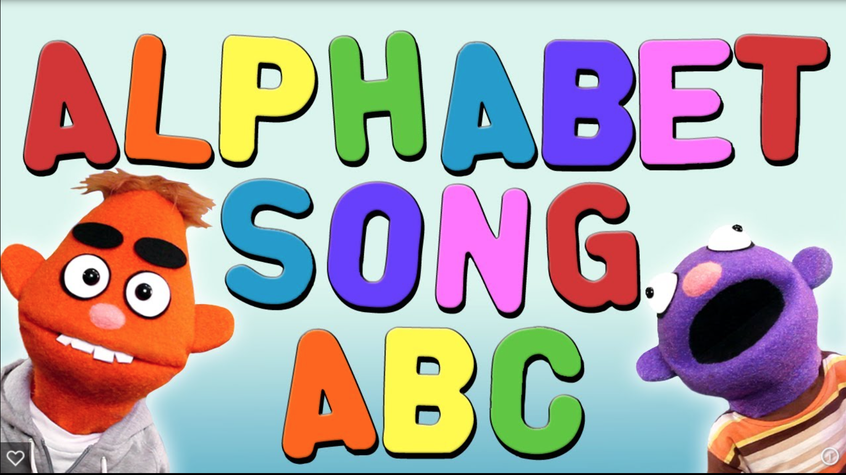
Auditory Encoding
Memorizing with Songs and Rhymes
ABC song for kids
Notes:
Auditory Encoding: encoding sounds.
You can take advantage of acoustic encoding by making songs or rhymes about information you hear.
For example Songs are easier to remember than if you had to memorize just the lyrics. This is how we can remember a song on the radio that we hadn’t heard in years and immediately start singing along to all the lyrics, because it was encoded acoustically. This also works with rhyming, rhymes are encoded acoustically as well.
There are a lot of great memory techniques using acoustic encoding. If any of you have seen the movie house bunny, after the main character meets someone new, she says there name out loud in a really weird voice. She is saying the name aloud and memorizing it acoustically becayse of the voice. Also if you make rhymes about peoples names, it really helps with memorizing, if you also add meaning to the rhyme, its even better. For example: if you meet a real estate agent named Mr. jones: your memory rhyme could be: Mr. jones is all about homes!! Or if he’s a really thin guy: Mr. jones is all Bones. This type of memory trick works so well because it encodes acoustically but also, it gives meaning to the person and it summons up a visual.
This is why we teach young kids with songs and rhymes. Everyone here learned the ABC song.
Even in High school, I had to learn a song to a song in math to remember the quadratic equation. I can even remember
a song that was for memorizing the Chinese dynasties

Slide 10
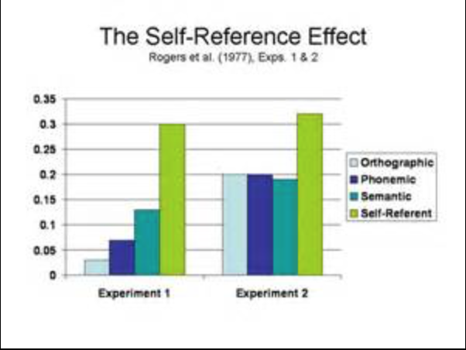
Semantic Encoding
William Bousfield
Meanings of words
Semantic encoding: deeper processing than visual or auditory
Self-reference Effect
High imagery words are encoded both visually and semantically
Notes:
Semantic encoding is the encoding of words and their meanings, as opposed to its visual or the sound it would make.
A psychologist name William Bousfield did research on semantic encoding
His experiment involved presenting participants with a set of 60 words, so a large set and asking them to recall as many of them as they could. The words actually could be divided into 4 categories of meaning but the participants were not told this and the words were presented in a random order.
The results of the study found that the participants would recall words from those categories, opposed to the order they were presented. This indicated that participants were paying attention to the meanings of the words as they memorized them.
Semantic encoding involves a deeper level of processing than either visual or acoustic.
Another great memory technic using semantic encoding is the self-reference technique. Which is the tendency for people to have better memory for information that relates to oneself.
So if you can relate the information you are trying to study for a test to yourself in any way, it will really increase recall.
A real world application of the self-reference effect I found was Gerald Lambert, who had a mouth wash campany in the early 1900s. He was trying to get people to buy mouth wash but he has very poor sale and low low product recognition. None of the adds they made were very memorable to consumers. So he came up with a new strategy to get people to link the mouth wash to themselves. He made a new add that showed the halitosis disease!!! (bad breath) and presented it as being so horrible to your health and that hismouth wash was the only way to stop you from falling victim to this terrible fate. Basically he found a way to make consumer tie the product to themselves so they would remember it more when they went to the store
Then last point, Tieing these encoding types together: semantic encoding back to visual encoding, those high- imagery words we talked about are encoded both visually and semantically.

Slide 11
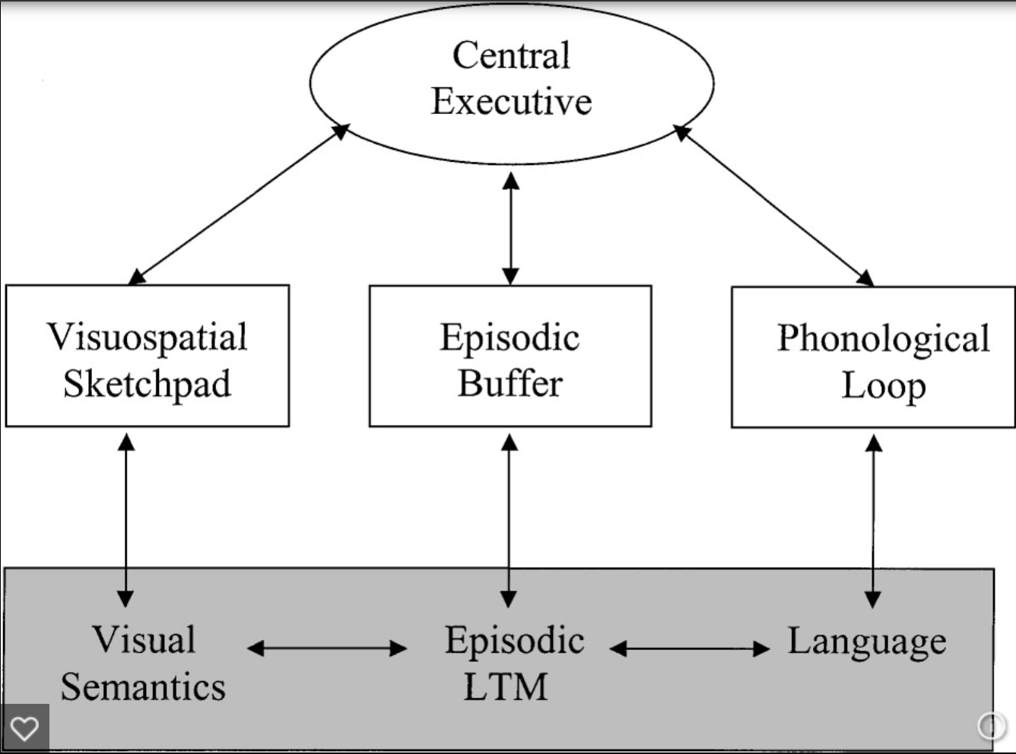
Storage
Creation of permanent record of information
Atkinson-Shiffrin Model
3 distinct phases: sensory, short, and long-term
Baddeley and Hitch Model
Notes:
Ok, so now that we have talked about how to successfully encode information into our brain, we are going to learn about storage, This is the creation of a permenent record of information in our brain, so that we can use the information later when we need it.
First off, know that there are multiple different models of memory storage, based off of different research, so we don’t have just one perfect model of how memories are stored. Your text focuses on the Atkinson-Shiffrin Model and touches a little on the Baddeley and Hitch Model, But know that these aren’t the only ones and if you continue in psychology, you’ll most likely learn more about this in your cognition class.
Atkinson-Shiffrin Model is the one we will spend the most time talking about and it has 3 stages: sensory, short term memory and long term memory and we are going to discuss these stages in the next few slides: but over all the model is based on the belief that memories are processed in the brain the same way that a computer would process something.
In contrast, is the Baddeley and Hitch Model: assumes that memories are stored more like a computer filing cabinet: pulling up different folders and places information inside, this the picture on the left.
Model has 3 parts of working memory: visiospatial sketchpad, episodic buffer, and a phonological loop: The type of short term memory used would depend on the external stimuli. The visiospatial sketch pad prcessing imagery, information about space, and is used in navigation. It is also responsible for manipulating images. The phonological loop handles both spoken and written words and manipulate speech based information.
The episodic buffer is responsible for linking the different types of information together and preparing it to be stored in the long term memory.
There is also a central executive part of memory that oversees the flow of information into these 3 parts, the executive also handles cognitive tasks like arithmetic and problem solving.

Slide 12
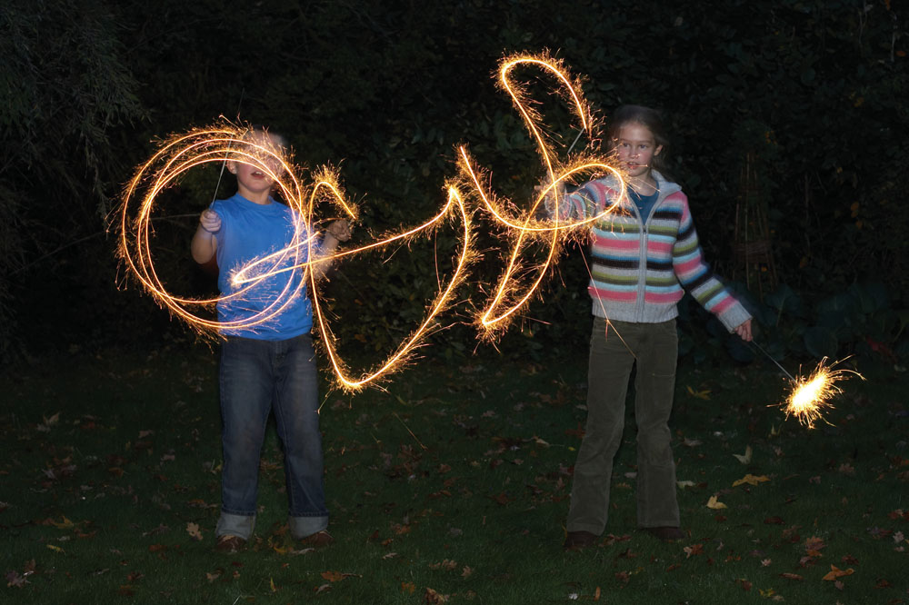
Sensory Memory
Atkinson-Shiffrin Model
Sensory registers
Hold information for initial processing
≤ 1 second
Associated with each sense
Iconic memory holds visual information
Provides continuity about stimuli coming from the environment
Selective attention focuses on information for transfer to working memory
Notes:
Going into detail about the first model of memory, the Atkinson-shiffrin Model
The first part of this model is the Sensory memory. The is the first stop for external stimuli
So this is Where you hold information for initial processing,
But this is Very Brief: only lasts about a second if that
There is a sensory store for each sense
If the sensory information we take in is not deemed valuable: we discard it, or forget it.
And.,..
Most is discarded: because we are constantly bombarded with so much information about our environments, we couldn’t possibly remember all of it. But even even this discarding of information after, the sensory store provides continuity about stimuli coming in from the environment.
You only move info into working, or short- term memory if it is deemed valuable using selective attention
An example of this
teacher’s clothes, if appropriate, you don’t think about it, but if he or she came to class in a clown outfit

Slide 13
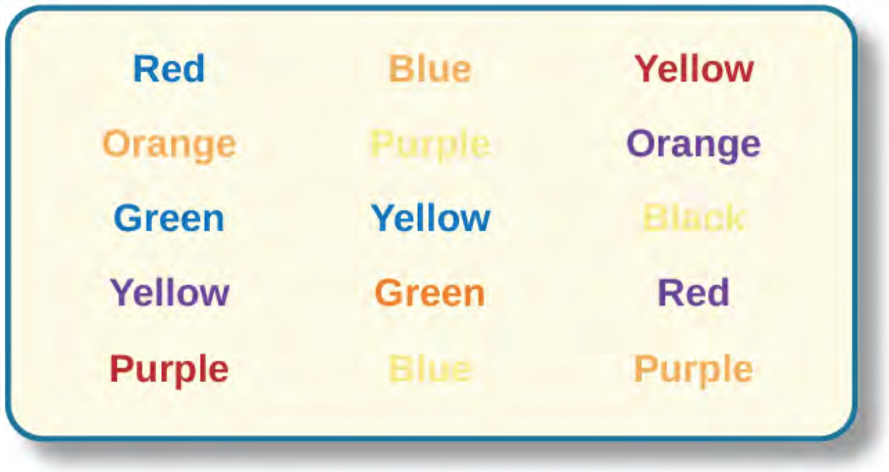
Stroop Effect
J.R Stroop
Name color more easily if it is printed in that color
Notes:
J.R. Stroop did a very significant study on sensory memory
https://www.youtube.com/watch?v=1EOe0GTk4xs&ebc=ANyPxKqW6nRXja9mfyB7VpmshdGmiN1qA1ZV9DmxK3lw8EKeB6Azc9zL1FYIjWtwsLWGHsmBCZqLvfWHrsa7NT19721hkDO9Ag

Slide 14
Short-term Memory
Short-term memory: stores limited amount of information for up to 18-20 seconds
Limits
Average adult can hold 5-9 chunks of information
Magic number 7
We’ll test these limits next!
Notes:
Temporary storage system that processes the sensory information.
Information is then either transferred into long-term memory or it is discarded or forgotten
Last about 18 seconds
George Miller conducted research on working mmory and found that most people can hold 5-9 chunks of information.

Slide 15
Test Your Immediate Memory Span
Read and remember each set of numbers:
9 2 5
Now, recall the numbers
8 6 4 2
Now, recall the numbers
3 7 6 5 4
Now, recall the numbers
6 2 7 4 1 8
Now, recall the numbers
0 4 0 1 4 7 3
Now, recall the numbers
1 9 2 2 3 5 3 0
Now, recall the numbers
4 8 6 8 5 4 3 3 2
Now, recall the numbers
2 5 3 1 9 7 1 7 6 8
Now, recall the numbers
8 5 1 2 9 6 1 9 4 5 0
Now, recall the numbers
9 1 8 5 4 6 9 4 2 9 3 7
Now, recall the numbers

Slide 16
Another Immediate Memory Span Test
Read and remember each set of words:
Cat boat rug
Now, recall the words
run beach plant light
Now, recall the words
suit watch cut stairs car
Now, recall the words
junk lone game call wood heart
Now, recall the words
frame patch cross drug desk horse law
Now, recall the words
clothes choose gift drive book tree hair this
Now, recall the words
dress clerk film base spend serve book low time
Now, recall the words
stone all nail door hope earl feel buy cope grape
Now, recall the words
age soft fall store put true small free check mail leaf
Now, recall the words
log day time chess lake cut bird sheet your see street wheel
Now, recall the words

Slide 17
The Power of Chunking
“The business professor in black suit parked his car in a handicapped spot.”
“The business professor in black suit parked his car in a handicapped spot.”
5205550467 vs. 520-555-0467
Chunks are meaningful groups of information
Chunking information can help increase the amount held in short-term memory
Notes:
This is a memorization strategy that involves taking a larger number of information and organizing it into more manageable chunks.

Slide 18
The Power of Chunking
Try to remember the following letters:
FB-IAO-LM-TVI-BMB-MW
Now, recall all of the letters
Let’s try that again:
FBI-AOL-MTV-IBM-BMW
Now, recall all of the letters
They were the same letters, just chunked differently

Slide 19
Another Chunking Example
Grocery List
1. tomatoes
2. turkey
3. milk
4. Cucumbers
5. Ham
6. Yogurt
7. strawberrries
8. Salami
9. eggs
Produce
Tomatoes
Cucumbers
Strawberries
Deli
Turkey
Ham
salami
Dairy
Milk
Yogurt
eggs
Notes:
You can either chunk this further by just chunking Prooduce, deli, dairy

Slide 20
Long-term Memory
Memory Consolidation: conscious repetition of information to move info from STM to LTM
Explicit and Implicit memory
No limits on capacity
Not every memory is strong: sometimes prompts are needed for recall
Notes:
Would be the hard drive of your memory
LTM includes everything you remember from a few minutes ago to to years ago.

Slide 21
Explicit Memory
Specific memories you can consciously recall
Ex: who wrote this textbook?
The Material on your last exam

Slide 22
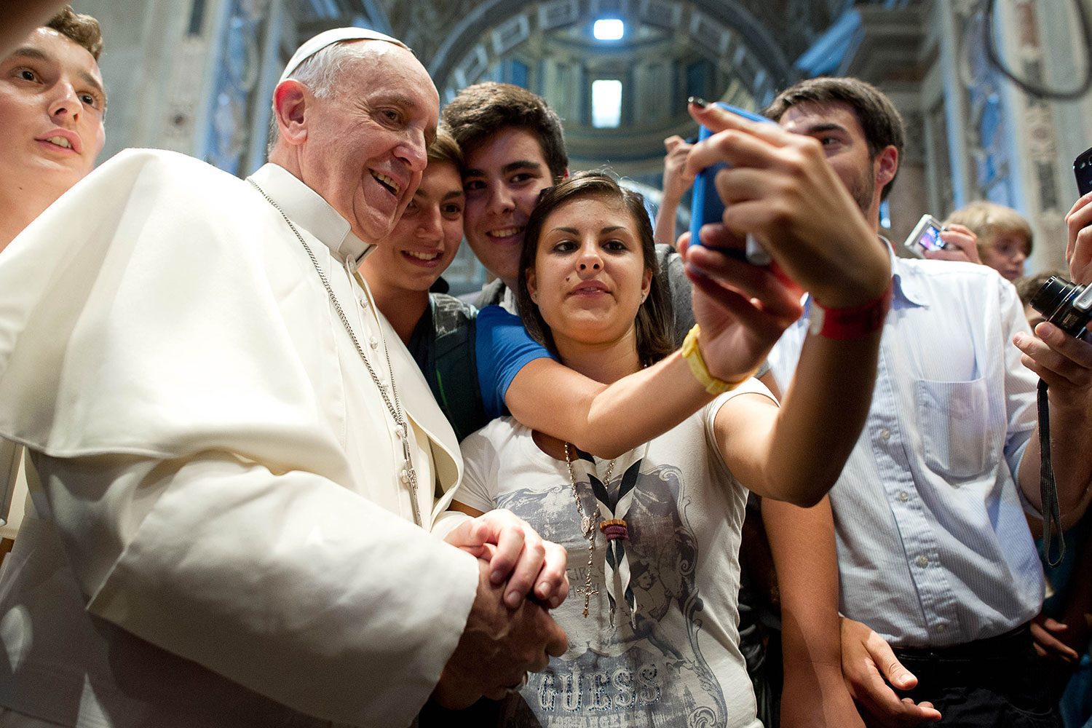
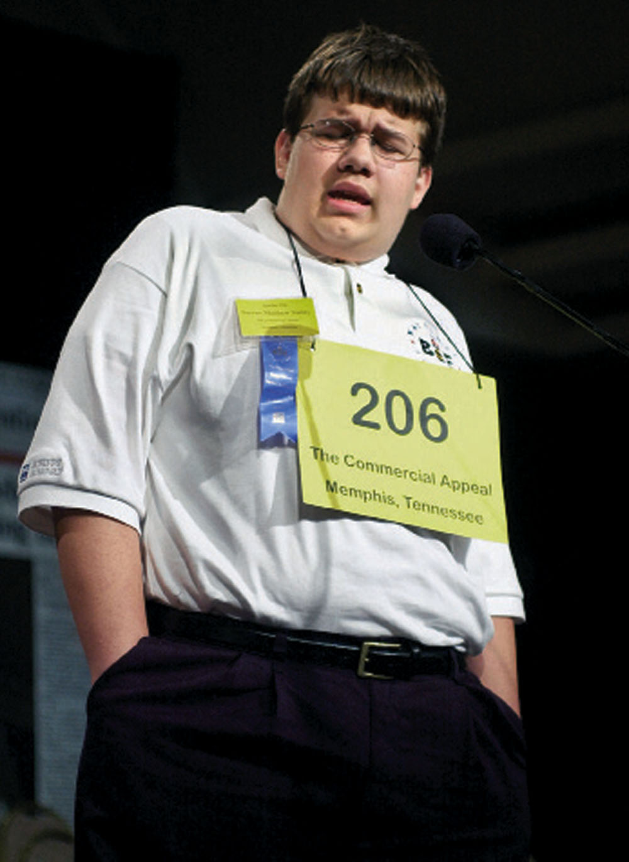
Types of Explicit Memory
Episodic Memory
Tulving
The what, when, where
An event, as it happened
e.g. meeting a celebrity
Semantic Memory
Generalized knowledge
e.g. spelling words, answer to the
question who was the first president of
the United States
Notes:
Episodic memory was first proposed by a psychologist named Tulving
We talked about semantic memory when we discussed encoding
Episodic: memory of particular places and particular times
Episodic memory involves both recollection of visual imagery and the feeling of familiarity of an event

Slide 23
Implicit Memory
Not a part of our consciousness
Memories formed from behaviors and experiences
Having fun friends as a small child makes you a friendly person
Notes:
Procedural memory: once you have learned how to ride your bike, you have done it so many times that it becomes procedural, you will remember how even after years.

Slide 24
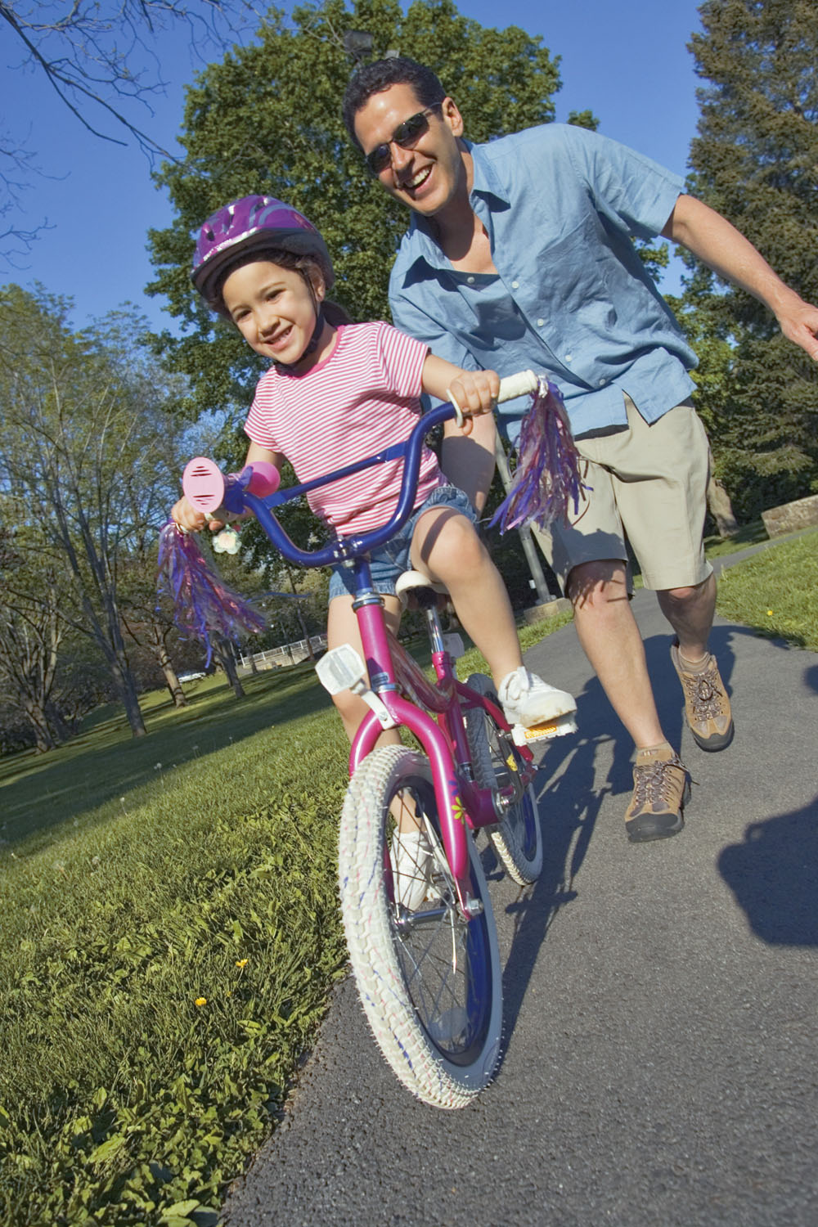
Types of Implicit Memory
Conditioning
Procedural Memory: stores information about how to do things
Ride your bike, brush your teeth, swimming
Notes:
Emotional conditioning

Slide 25
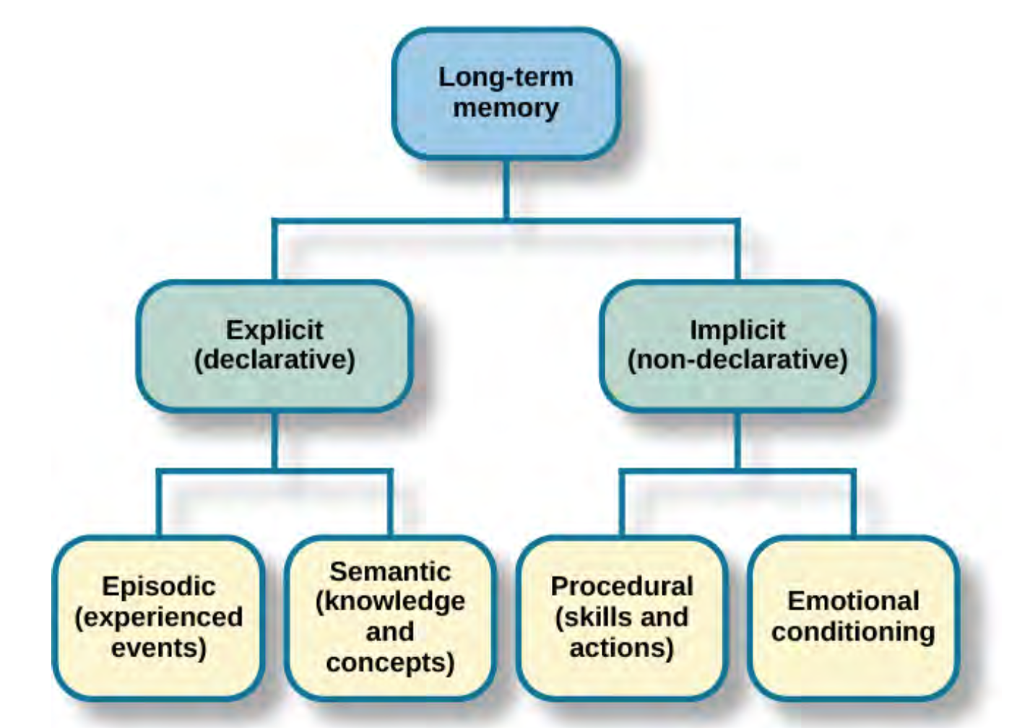

Slide 26
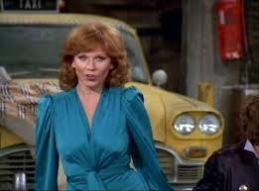
Hyperthymesia
People who have super episodic memory.
Autobiographical memory
https://www.youtube.com/watch?v=B-uFDhJPKOc
Notes:
Remember every event over the course of your life: meals, conversation, clothes, dates, everything
Very Rare: today, there’s only 12 known people with this ability
Marilu Henner: actress with Hyperthymesia

Slide 27
Retrieval
Getting information back out of storage
Vital to everyday functioning
3 types: recall, recognition, and relearning
Notes:
Retrieve information everyday, when you get ready for the day and brush your and your teeth, when you drive to work, you are retrieving information about those things from your storage.
Recall: accessing information without cues→ so like when you are taking a written essay exam, you are recalling that information without a cue
Recognition: when you correctly identify information that you previously learned. This is like when you take a multiple choice test: you have to recognize the correct response based oon the cue they gave you in the question
Recognition involves the process of comparison,
Relearning: exactly how it sounds: relearning, but this learning can happen much faster. So like I took French in high school but I didn’t touch it for a few years and forgot so much,, I could not have spoken it if you had asked me but then I decided to take an intro French class in college and The information came back a lot faster.

